Slide 1


STRAD18
Pre-Planning Review
03 June 2019
Land South of Mill Lane
(STRAD 18)
The Court House, Queen Street, Stradbroke
Presented by: David Smith, Jason Vince

Slide 2
Earlswood Homes

Slide 3



Who are Earlswood Homes
Developing in the Home Counties since 2005.
Usually build between 100-150 units p/a
Best New Homes Development 2017 & 2018.
Finalist for Large Business of the Year 2019 (Reigate & Banstead).
Tracking to build min 300 Homes p/a by 2023.
Commenced East Anglia Operations in Q4 2018.
2019 Turnover forecast £35 mil, increasing to £90 mil by 2023 (25% EA).

Slide 4
Market

Slide 5
Local Estate Agent Feedback
Properties taking 6-9 months to sell.
Price reductions of 5% - 10% had been necessary to close the sales.
Volumes of listings have been strong since January 2019.
Volumes of sales have not kept pace with listings.
Large new builds more difficult to shift (4-5 Beds).
Continued demand for bungalows but fewer being built.
Section 21 changes expected to increase supply.
A large Poultry Facility located close to Stradbroke, would present a price risk.

Slide 6
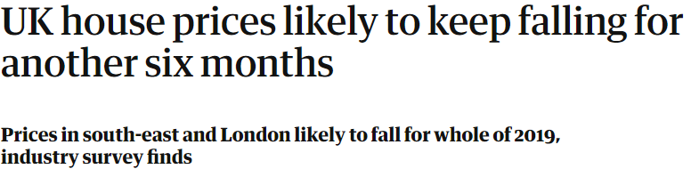
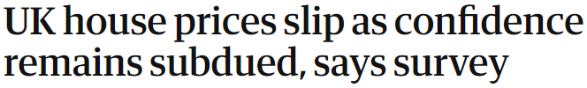


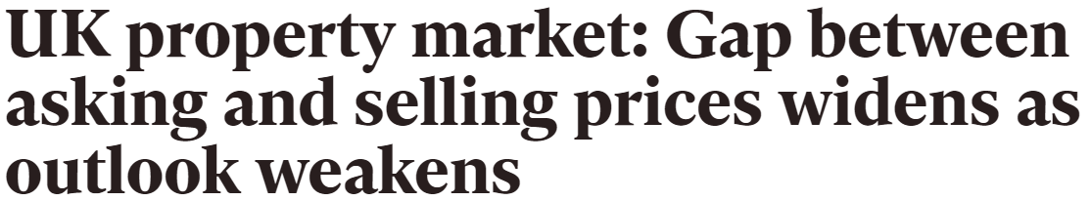

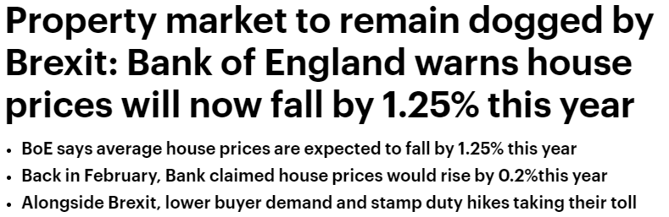
Papers / Economists (May 2019)

Slide 7
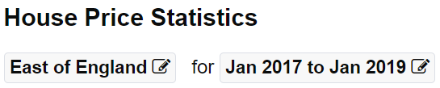
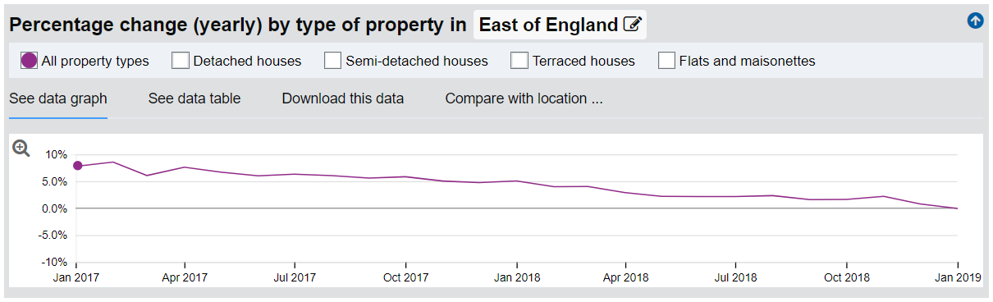
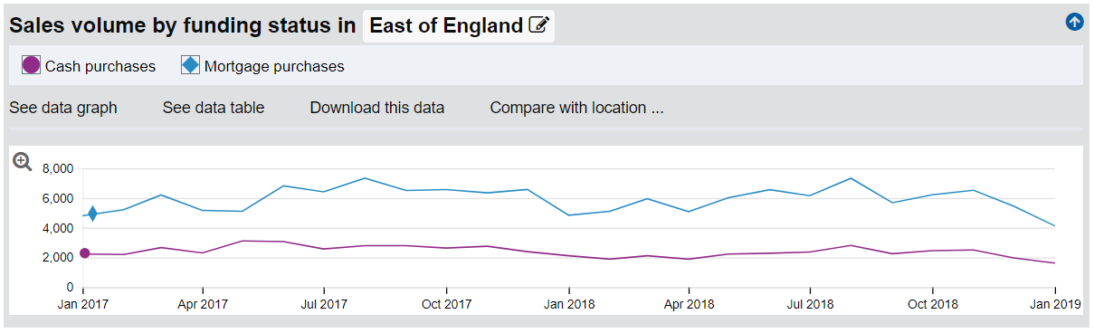
8 - 9%
Source: http://landregistry.data.gov.uk

Slide 8
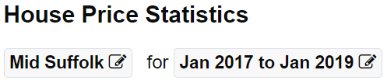
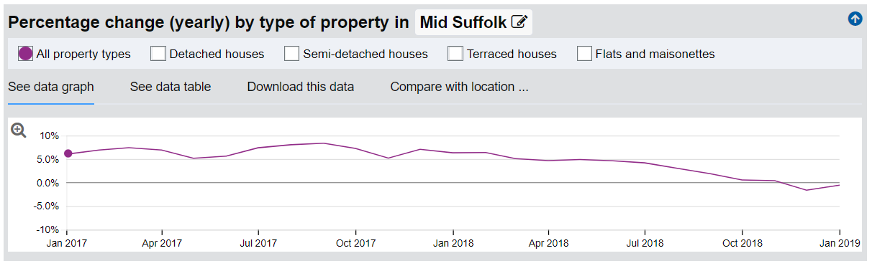
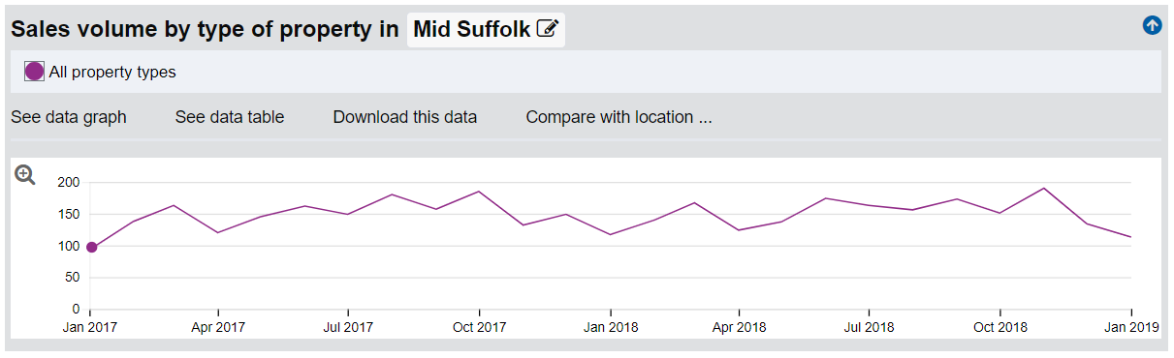
6 - 8%
Source: http://landregistry.data.gov.uk

Slide 9
Costs Trends & Concerns
* Construction cost source: Office for National Statistics https://www.ons.gov.uk/businessindustryandtrade/constructionindustry/datasets/interimconstructionoutputpriceindices

Slide 10
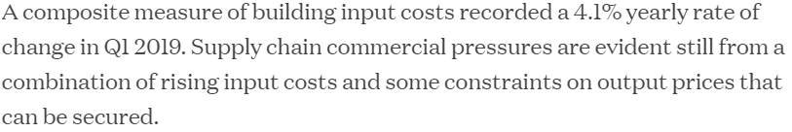
Costs Trends & Concerns
Observations
GBP – EUR Rate of Exchange trends.
Current tightness of labour market.
*Housing Construction Costs: Jan-Mar 2018 +4.2% & Jan-Mar 2019 +3.1% Total: 7.3%.
? over access to EU labour post Brexit and potential cost impact.
Industry Press (20-May-19)
* Construction cost source: Office for National Statistics https://www.ons.gov.uk/businessindustryandtrade/constructionindustry/datasets/interimconstructionoutputpriceindices
www.building.co.uk
https://www.building.co.uk/market-forecast/market-forecast-q1-2019-slowing-down/5099548.article

Slide 11
STRAD 18 & Implications

Slide 12
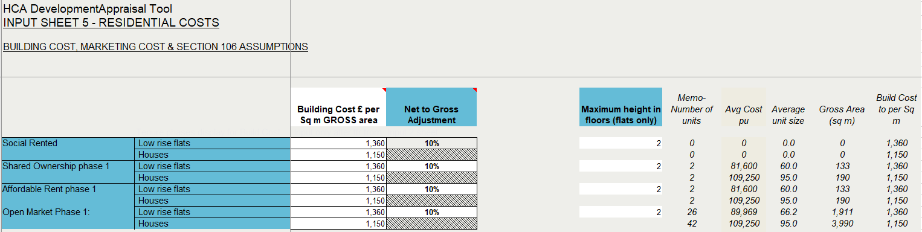
AECOM Assumptions (76 units incl. 10% Affordable)
Key Figures
Open Market Build: 5901 SQM (63,518 SQF)
Affordable Build: 647 SQM (6,964 SQF)
Total Build: 6,548 SQM (70,482 SQF)
Flats: 2,178 SQM (23,444)
Houses: 4,370 SQM (47,038)

Slide 13
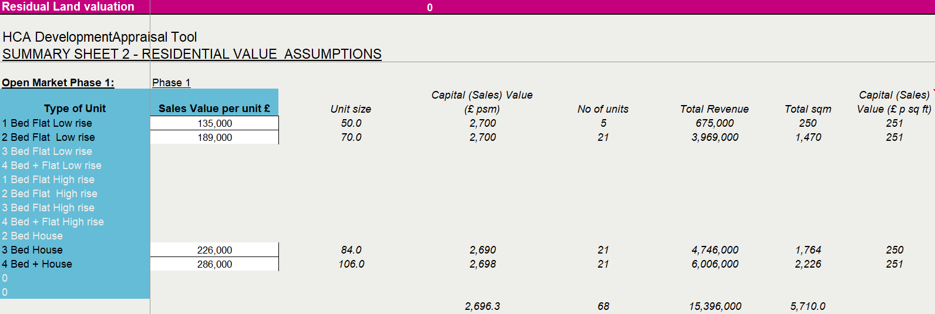
AECOM Assumptions - Open Market
Observations
Current Sales Price: -7%
Price/SQF reduces from £251 to £233 (-£17.5)
£233

Slide 14
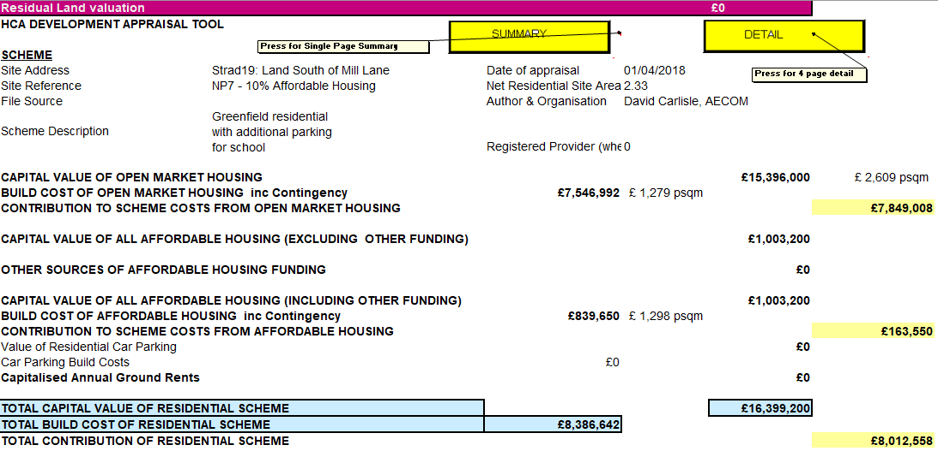

Observations
Total Build: 6,548 SQM (70,482 SQF)
YTD Adjustment on Sales Price: -£17.5
Sales Impact on scheme: -£1,233,435
Risk
£251 > £215 P/SQF
Impact: -£2,537,352

Slide 15
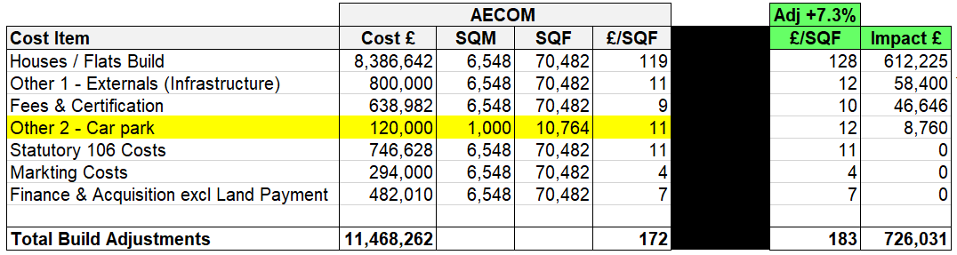
AECOM Costs
Continuing cost risk through build out to sale, increasing current exposures to circa £1.5m

Slide 16
Stradbroke Planning

Slide 17
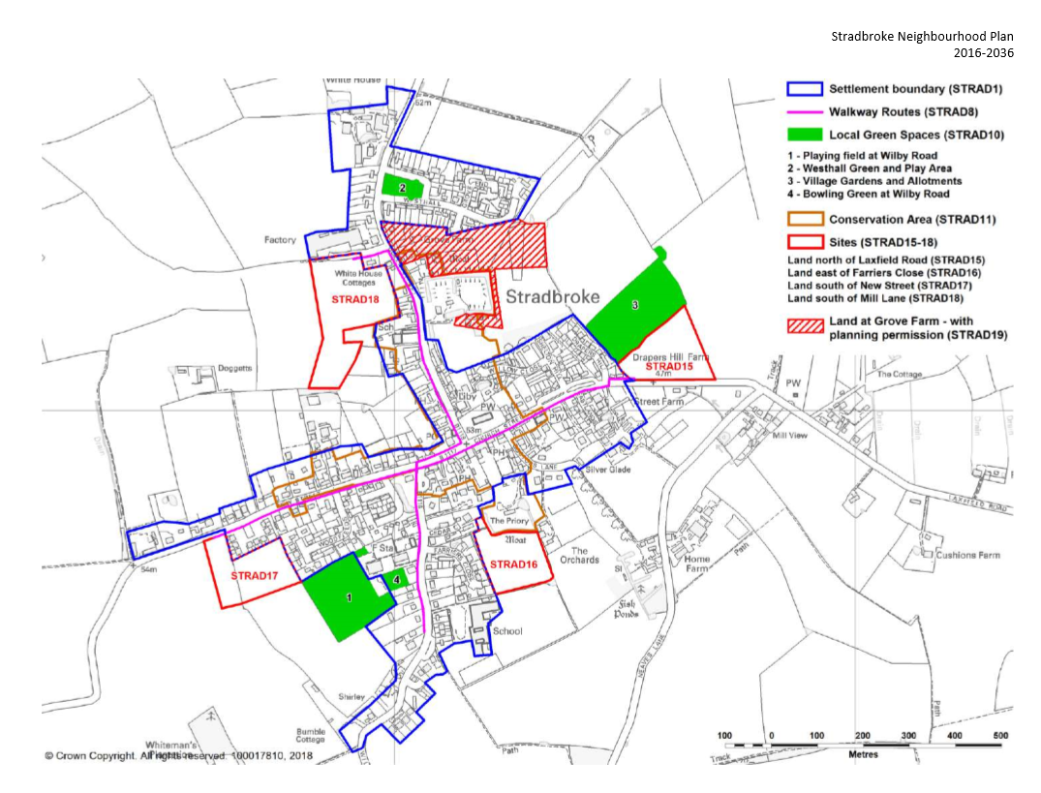
Summary
Using the current costings and sales prices, the current scheme is not deliverable.
Grove Farm (44 units) stalled.
Speculative Development risk if sites are not brought forward.

Slide 18
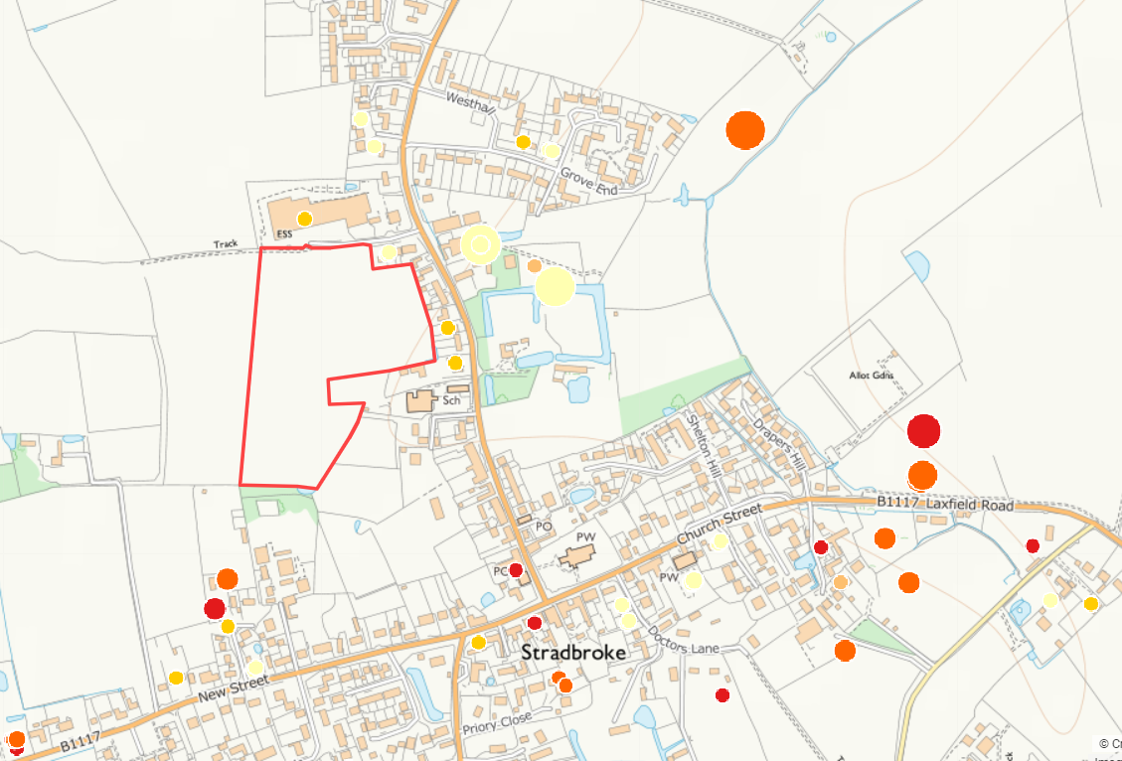
5+ Unit Applications: 8 for 145 units
Outline Withdrawn: 3 for 54 units
Outline Granted: 1 for 44 units
Outline Refused: 1 for 7 units
Outline Received: 2 for 34 units
Full Granted: 1 for 6 units
Outline DC/17/05571 40 units
Withdrawn (25th July 2018) S/LA
Outline 4005/14 44 units
Granted (24th March 2016) Trust ?
Outline DC/19/01343 28 units
Received (19th Mar 2019) P.Smith
Outline DC/17/01637 9 units
Withdrawn (12th Dec 2018) P.Smith
Outline DC/17/05565 7 units
Refused (19th July 2018) J.Brundle
Outline DC/18/01697 5 units
Withdrawn (29th May 2018) Dev
Outline DC/19/01930 6 units
Received (18th Apr 2019) J.Brundle
Full DC/17/06203 6 units
Granted (18th May 2018) Dev

Slide 19
Summary
Weakening Markets.
Increasing Costs.
Local sales prices P/SQF leave little room to absorb further risk.
Large Poultry Facility currently being considered for Horham.
Minimal Developer support of Stradbroke sites to date.
Grove Farm (44 units) stalled.
Speculative Development risk if sites are not brought forward.
Using the current costings and sales prices, the current STRAD18 scheme is not deliverable.

Slide 20
Earlswood Homes Objectives
To bring a viable scheme forward that delivers Affordable Housing and a workable return for the Land Owner & EHH.
To receive input from Stradbroke PC / Primary School on their priorities & preferences.
To work closely with the LPA / PC to deliver this important site.
Conclusion
Deliver a larger scheme (gradually) in order to help offset risks and support greater economies of scale.

Slide 21
Indicative Timelines
Pre-Planning Discussions with Stradbroke Sub-Committee (03-Jun)
Complete all planning stages by 31-May-2020.
Commence Build (Phase 1) by 30-Jun-2020.
Complete Build (Phase 1) by 30-Jun-2021.
Complete Build (Phase 2) by 30-Jun-2022.
Complete Build (Phase 3) by 31-Jun-2023.

Slide 22
Stradbroke PC Initial Feedback
& Questions

