Slide 1
SALC MID-SUFFOLK NORTH MEETING
21ST SEPTEMBER 2017
SUFFOLK HIGHWAYS & SUFFOLK’S HIGHWAYS
Mark Stevens
Assistant Director Operational Highways

Slide 2
Issues to be covered
Highways Transformation Programme reminder
Creating an integrated (‘One Team’) service
Service Delivery Centres
Service/network improvements
The financial challenge
An independent value for money test of Suffolk Highways by ‘Proving Services’

Slide 3
Highways Transformation Programme
Good work was being done in 2015 in the Highways Transformation Programme of the time but was being inconsistently implemented. A more robust structure to the programme was needed with different governance and levels of engagement to achieve the ‘one team aspiration’ set out in the highways contract that started in October 2013.
Five core priorities emerged:
Contract management (including performance management & quality management systems)
Integration (including systems/process reviews, staff & ICT matters)
Programme management (including response timescales)
Finance (including ordering and payments)
Asset management (including budget allocations & programme generation)
With an overarching need for significant levels of internal and external communication (including branding).

Slide 4
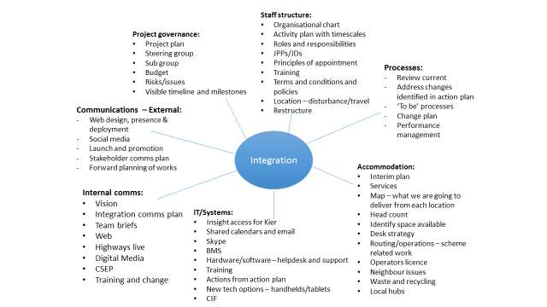
The components to integration

Slide 5
Non-Suffolk Highways services ..
Transport Strategy Group
Major Projects Team
Development Management Team
Road safety issues/improvement schemes
Flood Risk Management Team
Passenger Transport Team
All are potential works commissioners for Suffolk Highways

Slide 6
Suffolk Highways Senior Leadership Team

Slide 7
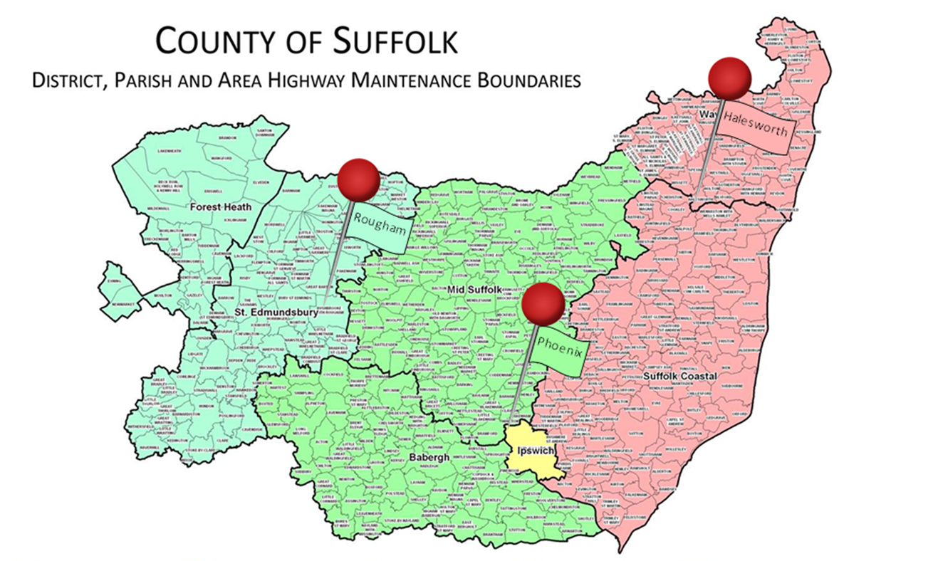
Functional operational service sites

Slide 8
Service Delivery Centre coverage

Slide 9
Service Delivery Centre coverage

Slide 10
Service Delivery Centre coverage

Slide 11
Suffolk Highways contact/information
Suffolk Highways webpages:
www.suffolk.gov.uk/highways
Reporting faults – the online tool www.highwaysreporting.suffolk.gov.uk
Customer Services Centre: 0345 606 6171
What’s happening in my area:
https://roadworks.org
Local issues/advice/support:
RoughamSDC@suffolk.gov.uk
HalesworthSDC@suffolk.gov.uk
PhoenixHouseSDC@suffolk.gov.uk

Slide 12
Comparative maintenance costs
SURFACE DRESSING
£3/m²
ASSET MANAGEMENT PROFILE
SURFACING & RECONSTRUCTION
£18/m²
PLANNED V REACTIVE
“PLANNED” PATCHING £30/m²
CUSTOMER
COMPLAINT
PROFILE
DEFECT RESPONSE £65/m²
QUICK RESPONSE
£95/m²

Slide 13
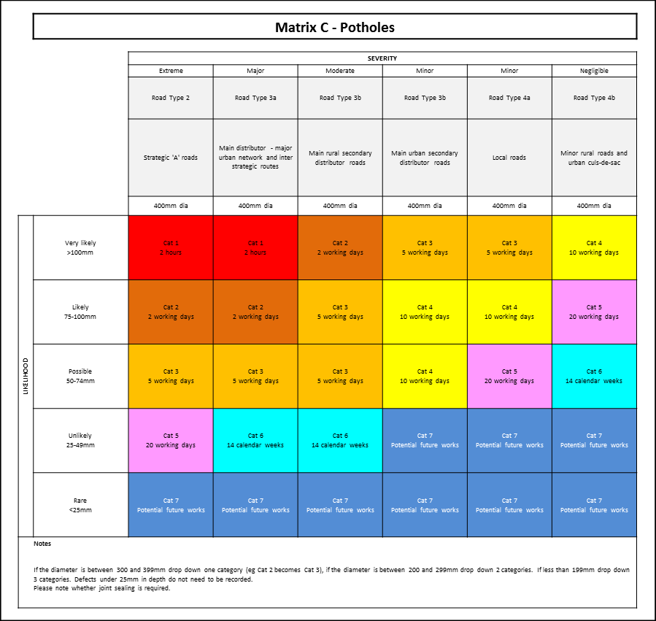
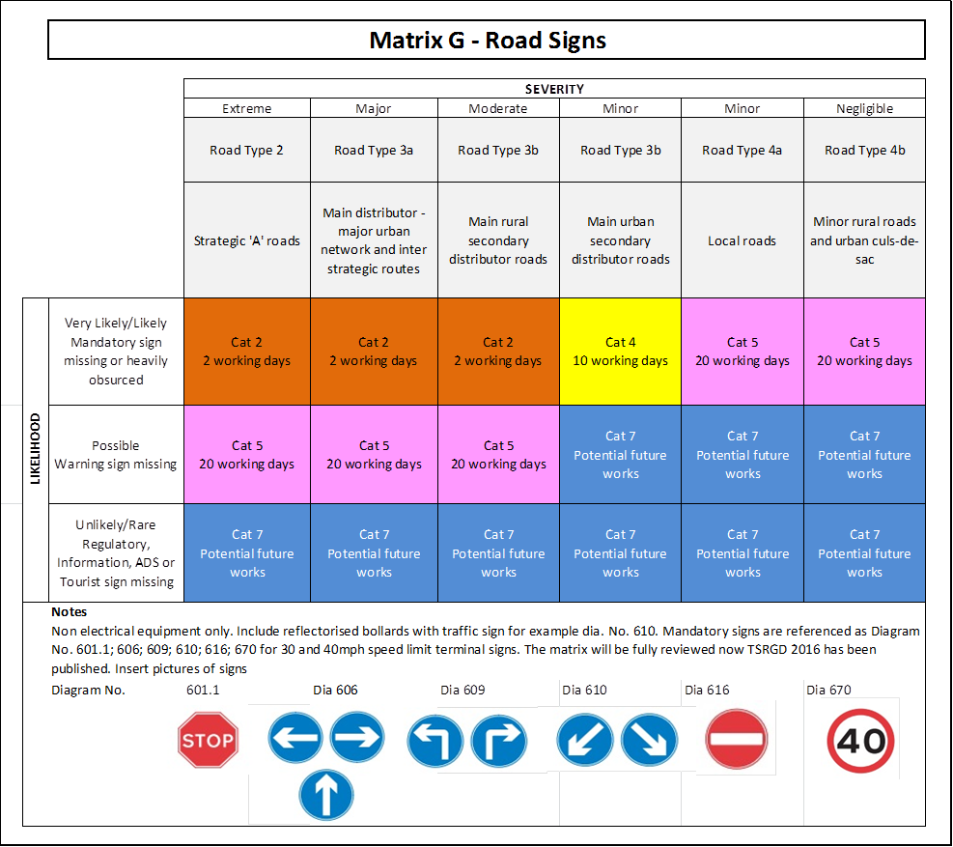
New HMOP matrices for defects
HMOP = Highway Maintenance Operational Plan, as approved by Cabinet on 12th July 2016
Extra column of severity required for green lanes?

Slide 14
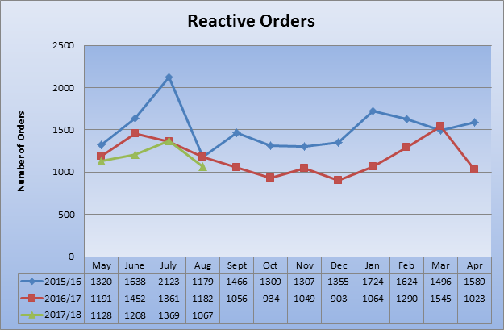
Controlling reactive maintenance

Slide 15
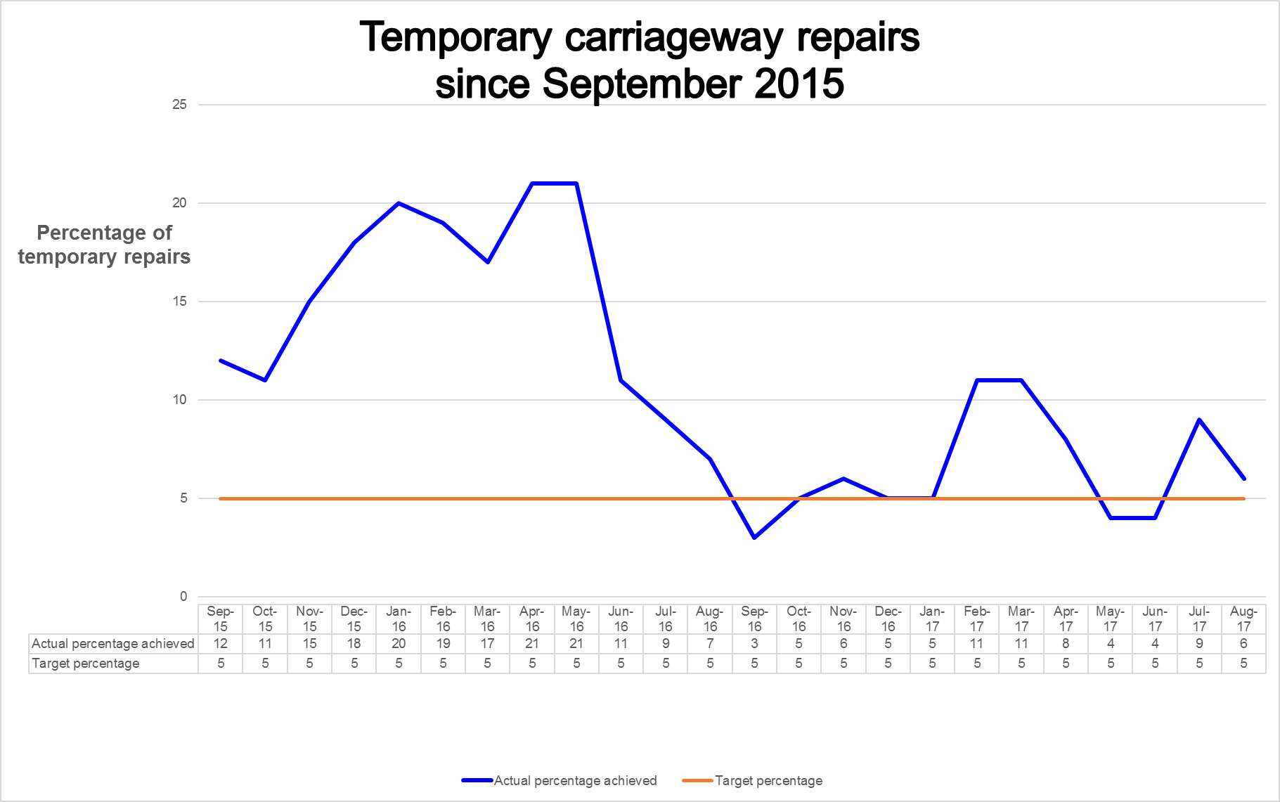
Changes to gang composition …

Slide 16
Overall road condition – latest data

Slide 17
Good road condition/repudiation
2014/15:
£645,453
2015/16:
£46,319
2016/17:
£30,049

Slide 18
Flooding and drainage
The situation in September 2016:
27 internal property flooding schemes were identified by the Area Highway Offices as requiring attention.
An integrated drainage team was established and investigations started
140 schemes were all to be properly prioritised, assessed and delivered – suggesting that there was 4 to 5 years of work that lay ahead
The situation at end of July 2017:
There were actually 32 internal property flooding schemes – of which 22 are now either complete or no further action is required
In spite of not being fully resourced, the integrated drainage team has progressed a significant number of schemes, many to completion
There are 392 schemes to be tackled rather than the 140 schemes initially identified
Scheme Status | Number of Schemes
Babergh | 78
Forest Heath | 20
Ipswich | 19
Mid Suffolk | 68
St Edmundsbury | 56
Suffolk Coastal | 116
Waveney | 35
Grand Total | 392

Slide 19
Area office traffic management scheme requests
 | Parish | Details | Road Numbers |  |  | Parish | Details | Road Numbers
1 | Thurston | Pokeriage Corner (Thurston Road / Beyton Road / Thedwastre Road) | C692/ C560/ U4920 |  | 29 | Leavenheath | B1068/C731 junction | B1068/C731
2 | Henley | Bells Cross junction | C458/ C441/ C459 |  | 30 | Long Melford | A134/C711 Bull Lane staggered junction | A134/C711
3 | Thurston |  | C693/ C560 |  | 31 | Long Melford | C711 Bull Lane between Cordell Road & Hall Street | C711
4 | Thurston | Fishwick Corner | C692/ C693 |  | 32 | Hadleigh | Benton Street | B1070
5 | Elmswell | Church Road/ Cross Street/ New Road/Warren Lane | C401 / C401 / C558 / C403 |  | 33 | Lavenham | Water Street | A1141
6 | Woolpit Green |  | C434/ U4945 |  | 34 | Kersey | A1071 approach to U8327 junction to Kersey | A1071 / U8327
7 | Barking | Barking near Barking Hall | B1078 |  | 35 | Leiston | Lovers Lane
8 | Claydon | Claydon Roundabout | B1113/ C492 |  | 36 | East Area | Various Rural Roads
9 | Finningham | B1113/ C555 | B1113/ C555 |  | 37 | Eyke |  | A1152
10 | Stowmarket to Old Newton | Stowmarket to Old Newton | B1113 |  | 38 | Melton | Old Maltings Approach
11 | Old Newton to Bacton | Old Newton to Bacton | B1113 |  | 39 | Woodbridge | Sandy Lane & Historic Core B1438
12 | Great Blakenham | Hackney's Corner, Great Blakenham | B1113/ C496 |  | 40 | Tunstall |  | B1069
13 | Wetheringsett cum Brockford | Town Lane | A140/ U5322 |  | 41 | Tunstall Common | Tunstall Common
14 | Stoke Ash | White Horse Inn | A140/ C569/ C547 |  | 42 | Farnham Bend
15 | Stoke Ash | Roman Way | A140/ U5329 |  | 43 | Benhall | Primary School
16 | Akenham | Henley Road, near Hill Farm | C441 |  | 44 | Melton | level crossing
17 | Akenham | Henley Road/ Lower Road | C441 / U3340 |  | 45 | Saxmundham | A12 Saxmundham Bypass Rendham Road central reserve | A12
18 | Hoxne | Chickering Corner | B1118/ C522 |  | 46 | Clopton | Kidby Cottage B1079 | B1079
19 | Weybread | B1116/ B1123 | B1116/ B1123 |  | 47 | Leiston | Station Road
20 | Ringshall | Lower Farm Road | B1078/ C447 |  | 48 | Tuddenham St Martin |  | Various Roads
21 | Hemingstone | Hare and Hounds Corner | B1078/ C459 |  | 49 | Burgh | Mill Hill | 49
22 | Hemingstone | B1078/ C448/ C441 | B1078/ C448/ C441 |  | 50 | Swilland | Gibralter cross roads between Ashbocking and Otley | 50
23 | Kersey | Crossroads at Kersey | A1141/C723/C724 |  | 51 | Brandeston | west of village on tight bend | 51
24 | Long Melford | B1064 Rodbridge Crossroads | B1064 |  | 52 | Woodbridge | Vicarage Hill | 52
25 | Long Melford | The Green | B1064 |  | 53 | Leiston | Sizewell Gap | 53
26 | Glemsford | Fair Green | U7331 |  | 54 | Blythburgh | A12 | A12
27 | Monks Eleigh | A1141/B1115 junction | A1141/B1115 |  | 55 | Saxmundham | Saxmundham A12/B1119 Rendham Road Junction | A12/B1119
28 | Nedging | B1078 junction with U8403 (Wallow Lane) | B1078 / U8403 |  | 56 | Worlingham | Lowestoft Rd | C966

Slide 20
Funding for traffic management
Suffolk Highways’ revenue maintenance budget = £0
Suffolk Highways’ capital maintenance allocation = £0
On-Street Car Park surplus now funding CPE development/delivery = £0
Strategic Development’s Integrated Transport allocation = £3.24m but this is the only source for match-funding DfT and LEP schemes or to develop new schemes for bid purposes (e.g. latest NPIF round). Used for:
£3 million at Eastern Relief Road;
£2m on Beccles Relief Road;
£0.5 million Bury St Edmunds Sustainable Routes
Ipswich Station Forecourt and Queen Street improvements
NDORS (National Driver Offender Retraining Scheme) = circa £600k (but would require Suffolk Roadsafe Board approval & be innovative)
So, Local Highway Budgets = £500k/p.a. is the only current option ……..

Slide 21
Impact of traffic management?
If targeted at high frequency accident clusters sites = reduced KSIs
If targeted at 20mph zones, actually results in:
no speed reduction (and no police speed enforcement)
additional maintenance liability (signs, marking, road humps etc)
increased air and noise pollution (Gov’t now suggest remove calming measures to combat pollution problem)
unintended accidents? (traffic calming measures caused 1607 accidents in Great Britain over the 10-year period from 2006 to 2015, including 23 people killed and 275 people receiving critical injuries)
An unnecessary longer-term restriction: DfT prediction of traffic growth between 2010 and 2040:
Strategic route network – up to 60% growth
Principal road network – up to 51% growth
‘Other’ roads – up to 54% growth
So, is a traffic management strategy needed? The SCC KSI target?

Slide 22
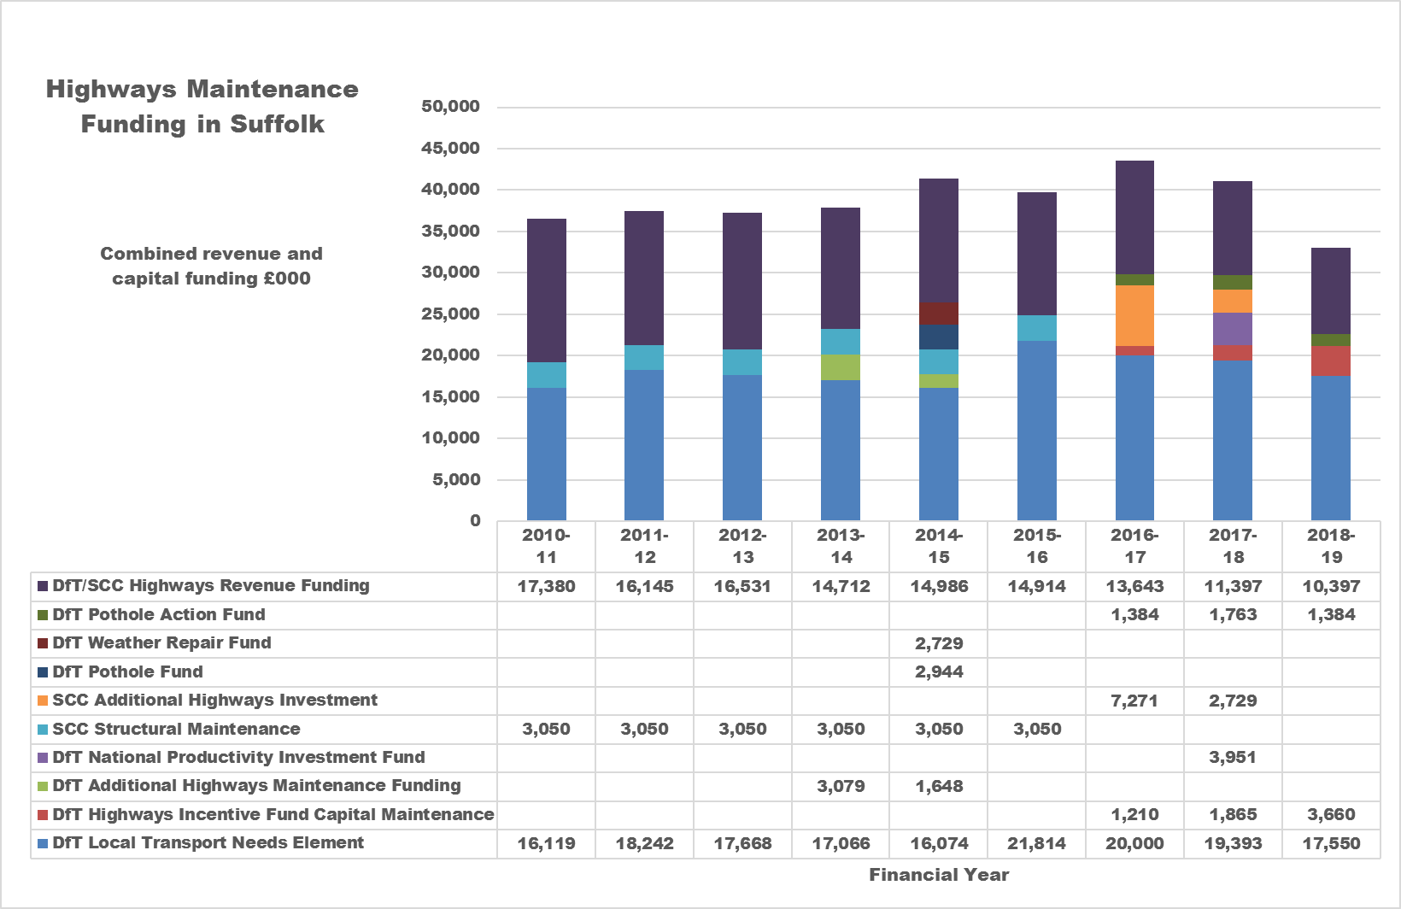
Looking after Suffolk’s highways

Slide 23
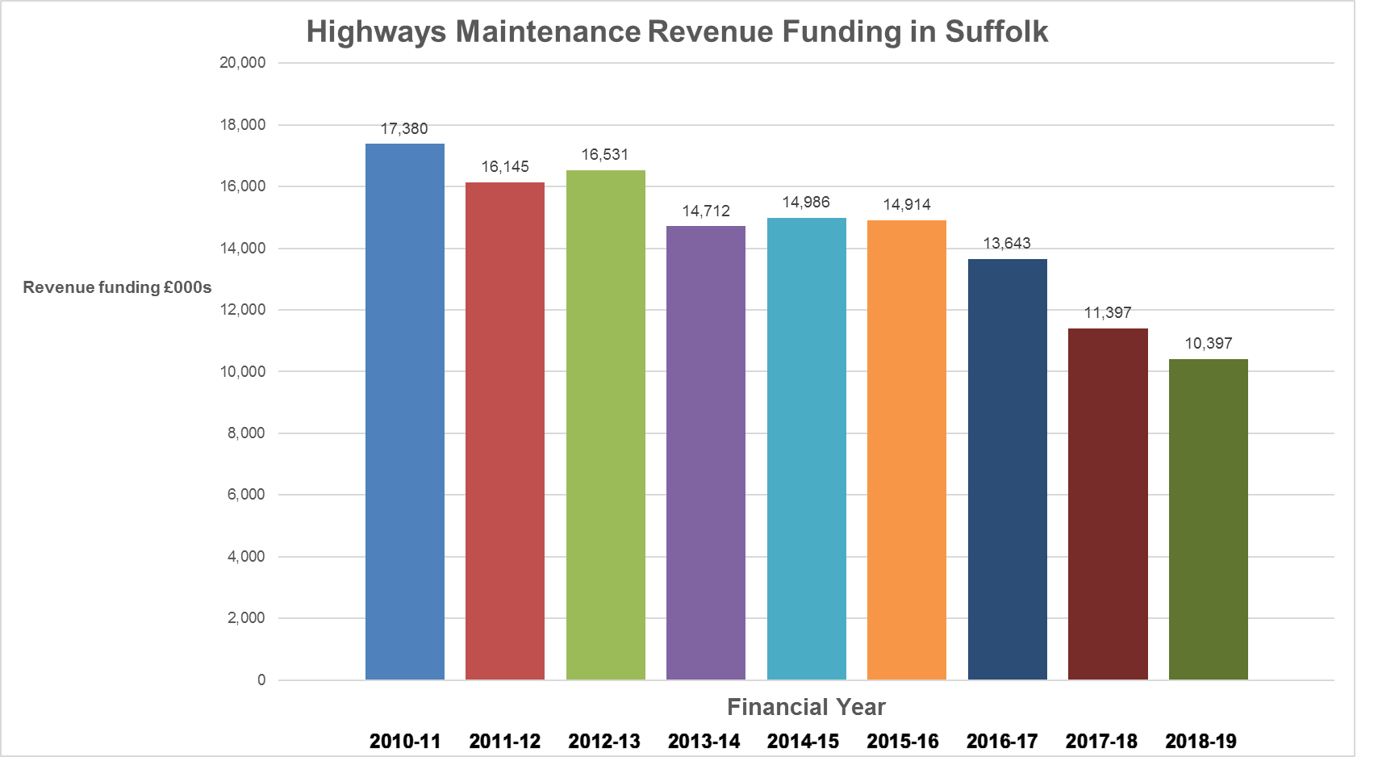
Funding the routine work ……
34% less
40% less

Slide 24
The revenue budget split ……
MAINTENANCE ELEMENT | 2017/18 REVENUE BUDGET | CONTEXT
Reactive mtce (incl. OOH) | £2,160k | 6,618km rds, 4,000km f’way, 5,725 ROW
Emergency mtce fixed cost | £286k | 2-hour make safe
Street lighting energy | £1,900k | 68,500 street lights
Street lighting maintenance | £1,155k | Including central management system licences and column testing
Drainage (gullies, digouts, grips) | £1,500k | Annual cleanse of 130,000 road gullies (13,236 ‘new’ gullies)
Winter maintenance | £1,500k | 51% of network treated
Service level agreements | £739k | District/borough council works – urban grass cutting, tree mtce etc
Local management overhead | £516k | Vehicles, depots (maintenance & utility bills) & personnel
Rural grass cutting | £183k | 2 cuts per annum on A/B roads and 1 cut C/U roads
Environmental works | £290k | Covers weed control, skirting, hedge and tree maintenance
ITS (traffic signals) maintenance | £387k | 122 junctions, 190 crossings (a growing number)
ITS energy | £143k | Above traffic signals equipment & 109 signs
Structures maintenance | £348k | 1,244 bridges, culverts, retaining walls (including inspection costs)
Road condition surveys | £160k | Annual BVPI assessment
Sign cleaning | £96k | 102,000 road signs (one gang, less than £1 per sign per year)
Road markings and studs | £34k | 3,100km of road markings (now mainly capitalised)
TOTAL | £11,397k | For a £7.9billion asset = replacement every 203 years (& energy paid)

Slide 25
The capital allocation split ……
MAINTENANCE ELEMENT | 2017/18 CAPITAL ALLOCATION | CONTEXT | 2018/19 CAPITAL ALLOCATION?
Carriageway machine surfacing | £4,150k | 247k m² or approx. 38 km of total 6,618km roads | £2,419k
Carriageway surface dressing | £7,896k | 2.13million m² or approx. 325km (365 sites) | £4,300k
Surface dressing pre-patching | £2,642k | For 1.16million m² of dressing in 2018/19 (230 sites) | £1,000k
Programmed patching | £478k | ‘Category 7’ works | £1,000k
Road markings replacement | £370k | Replacing part of 3,100km of road markings | £400k
Footway works | £1,286k | Incl. reconstruction, resurfacing, patching & slurry | £1,300k
Planned drainage programme | £1,800k | Internal flooding & highest priority sites | £1,800k
Supplemental drainage works | £440k | Site investigations and minor repairs | £440k
General street furniture | £94k | Road signs, pedestrian guardrails, guard posts | £94k
Vehicle restraint systems | £94k | 3-year retensioning cycle & replacement | £94k
Structures programme | £2,000k | Major repairs to bridges, retaining walls & culverts | £2,000k
Public rights of way | £240k | Includes PROW bridges/structures & maintenance | £240k
Street lighting | £2,700k | Lighting column replacement & LED conversion | £2,700k
Traffic signal replacement | £307k | Replacement of signals and controllers (20-year) | £307k
Reserve | £656k | Held to offset capital/revenue overspend | £500k
Local management overhead | £2,116k | Cost of depots, vehicles, materials and resources | £2,000k
2016/17 costs | £2,418k | Financial commitments from preceding year | £2,000k
TOTAL | £29,701k | Single year reduction of £7.107m (24%) | £22,594k

Slide 26

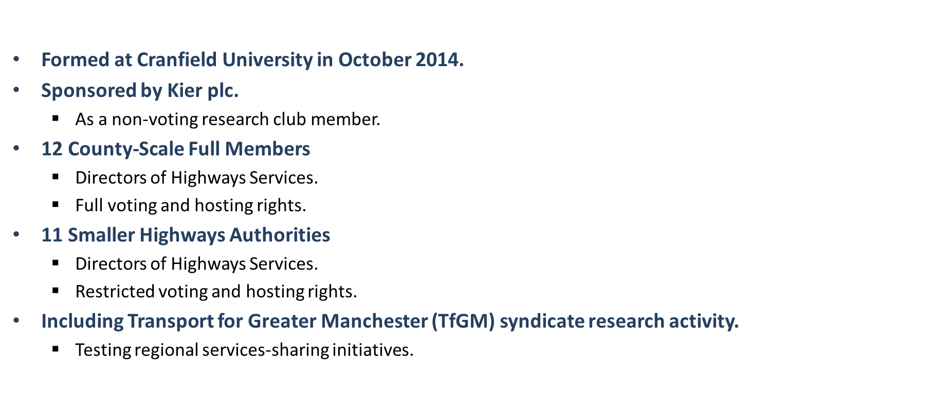

Proving Services/Future Highways Research Club

Slide 27
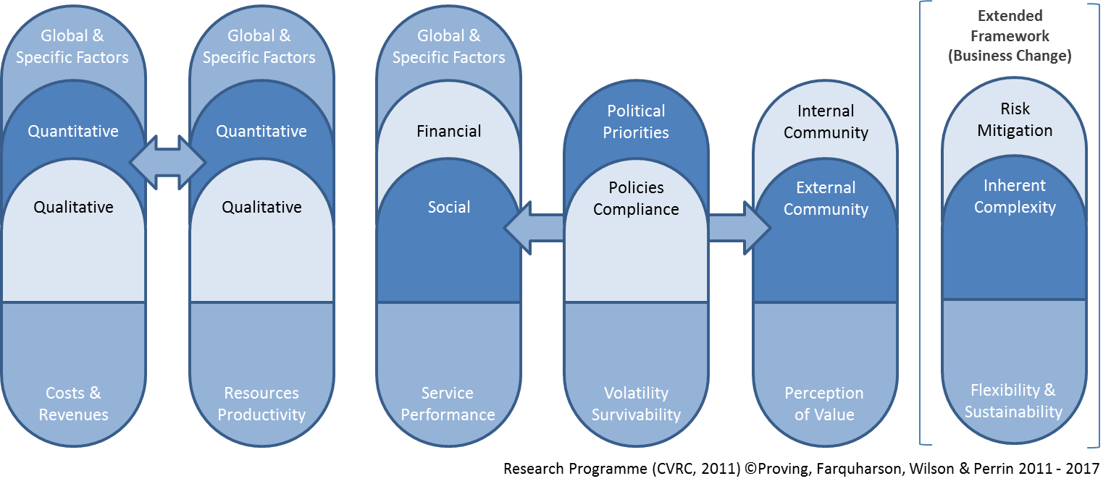


Value for money assessment

Slide 28
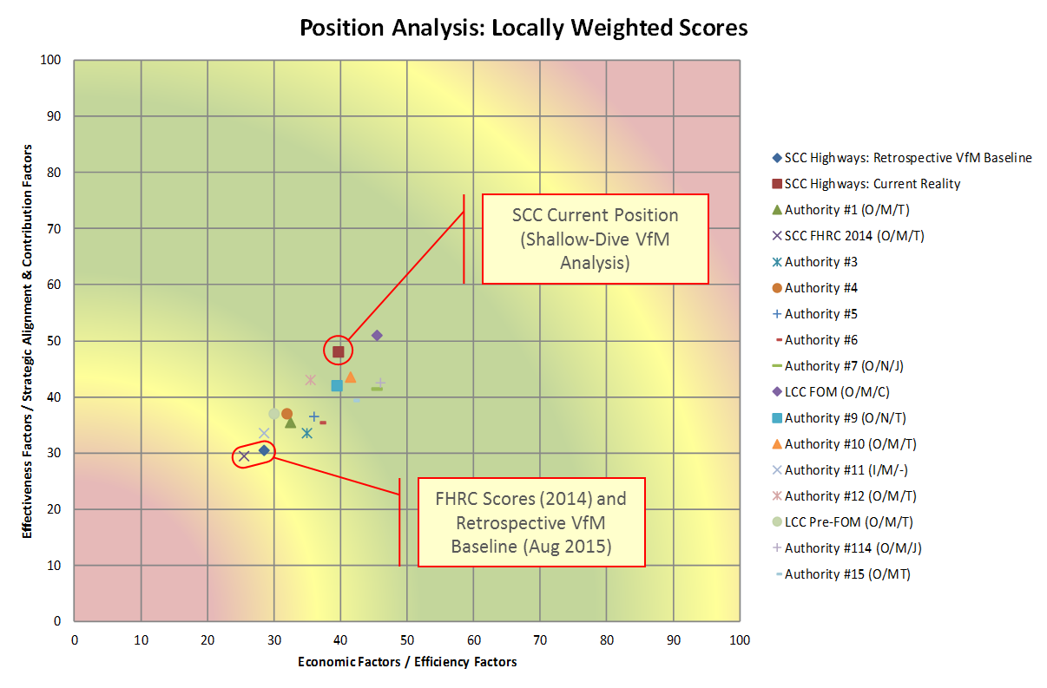
SCC and other local authority assessments

Slide 29
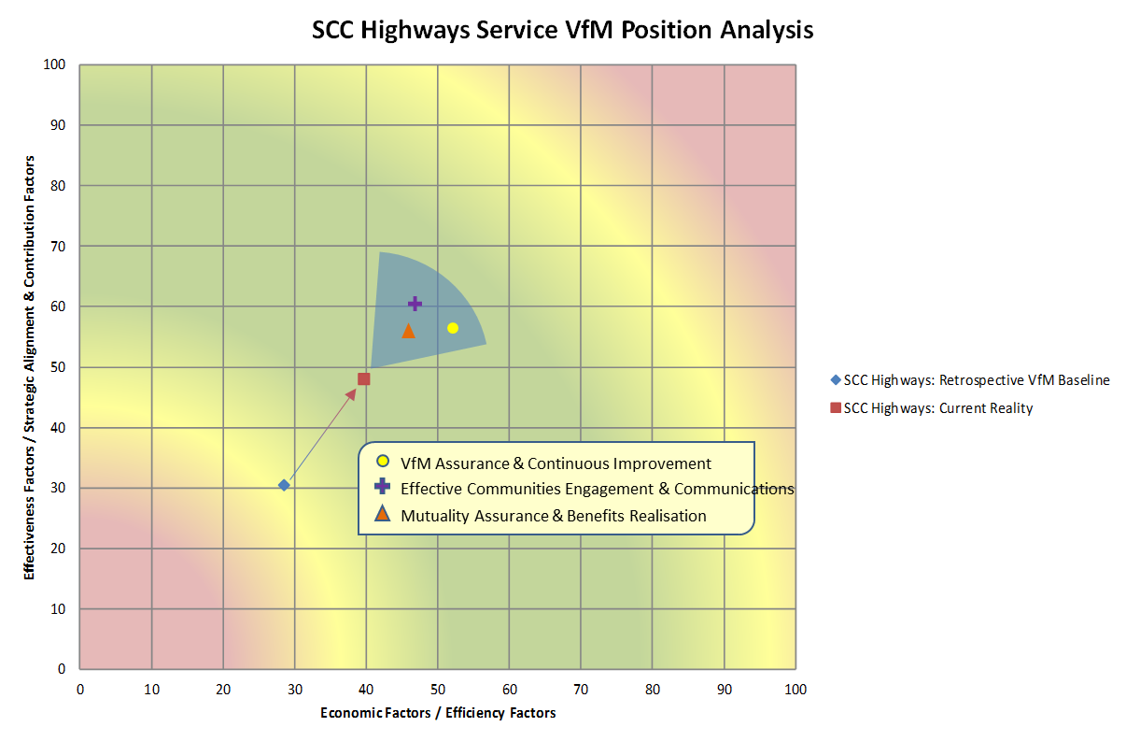
Potential to improve to flagship status …

Slide 30
Any questions?

